Slide 1
-The Conflict Room
Mani Nilchiani
MFA DT / Major Studio Interface
Prof. Jonah Brucker-Cohen

Slide 2
-The Conflict Room: Problem Statement
The Conflict Room is an interactive installation piece that explores the impact of biased media on the formation of public opinion, especially nations in conflict, and more specifically, Iran and the U.S.
The mutual demonization of the two parties that succeeded the Iranian revolution of 1979 which resulted in a complete communication blackout between the two nations.
Both the American and Iranian sides have come to build and reinforce their own stereotypes, consequently contributing to the tension.
In a context where the media is the only channel to access information about the rival party, direct conversation between the citizens of the two nations appear to be an effective solution to resolve issues in a direct and independent manner.

Slide 3
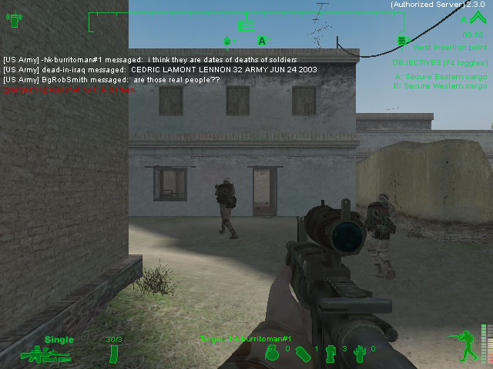
Precedents
Dead in Iraq: Joseph DeLappe
http://www.unr.edu/art/delappe/gaming/dead_in_iraq/dead_in_iraq%20jpegs.html

Slide 4
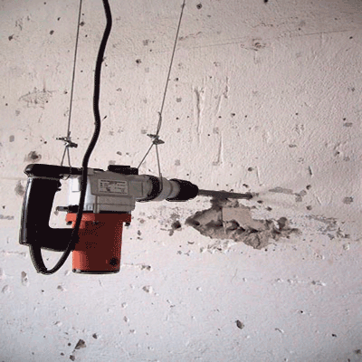
Precedents contd.
Alerting Infrastructure: Jonah Brucker-Cohen
http://www.coin-operated.com/

Slide 5
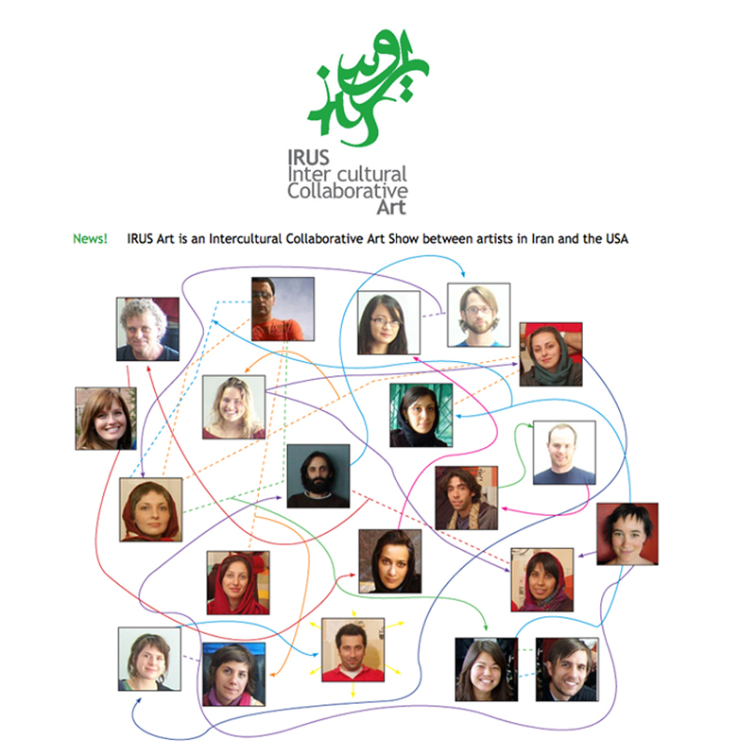
Precedents contd.
IRUS: Morehshin Allahyari & Andrew Blanton
http://www.irusart.org/

Slide 6
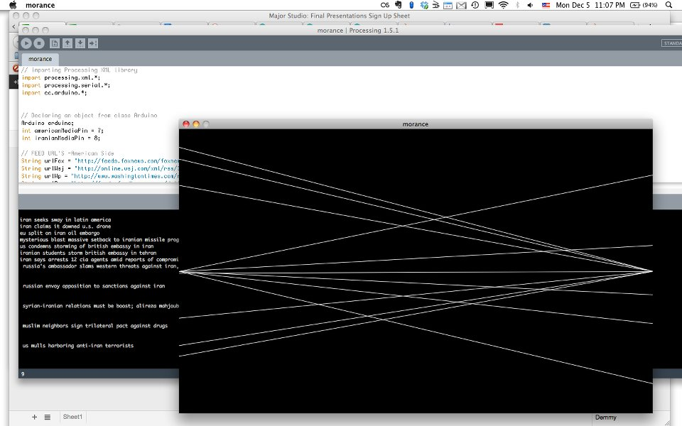
Initial Prototypes
Beginning with Processing

Slide 7
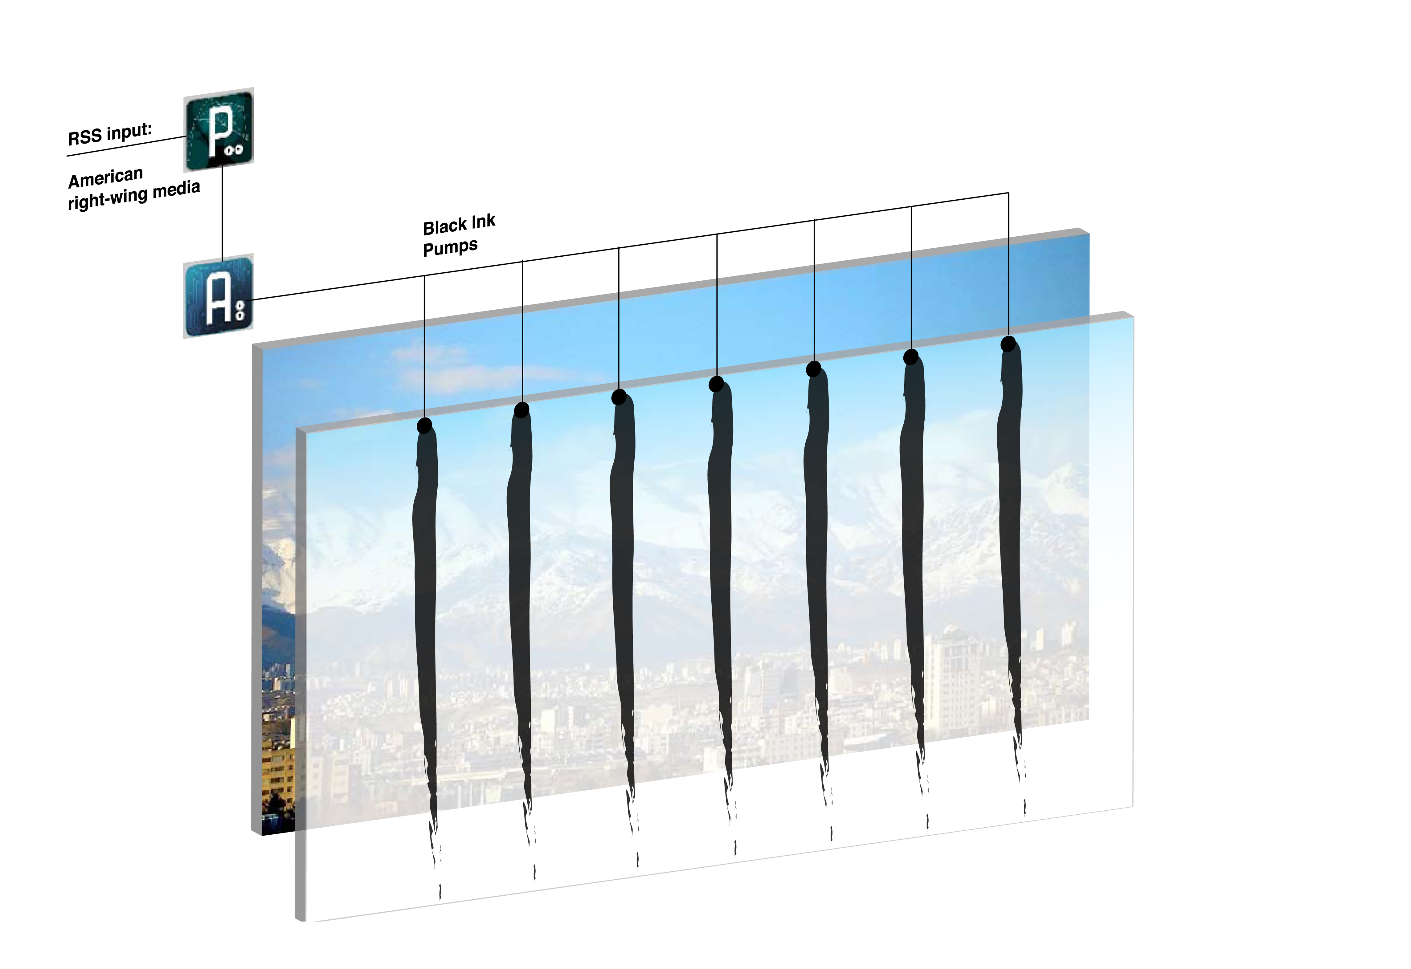
Initial Prototypes
How it would look like

Slide 8
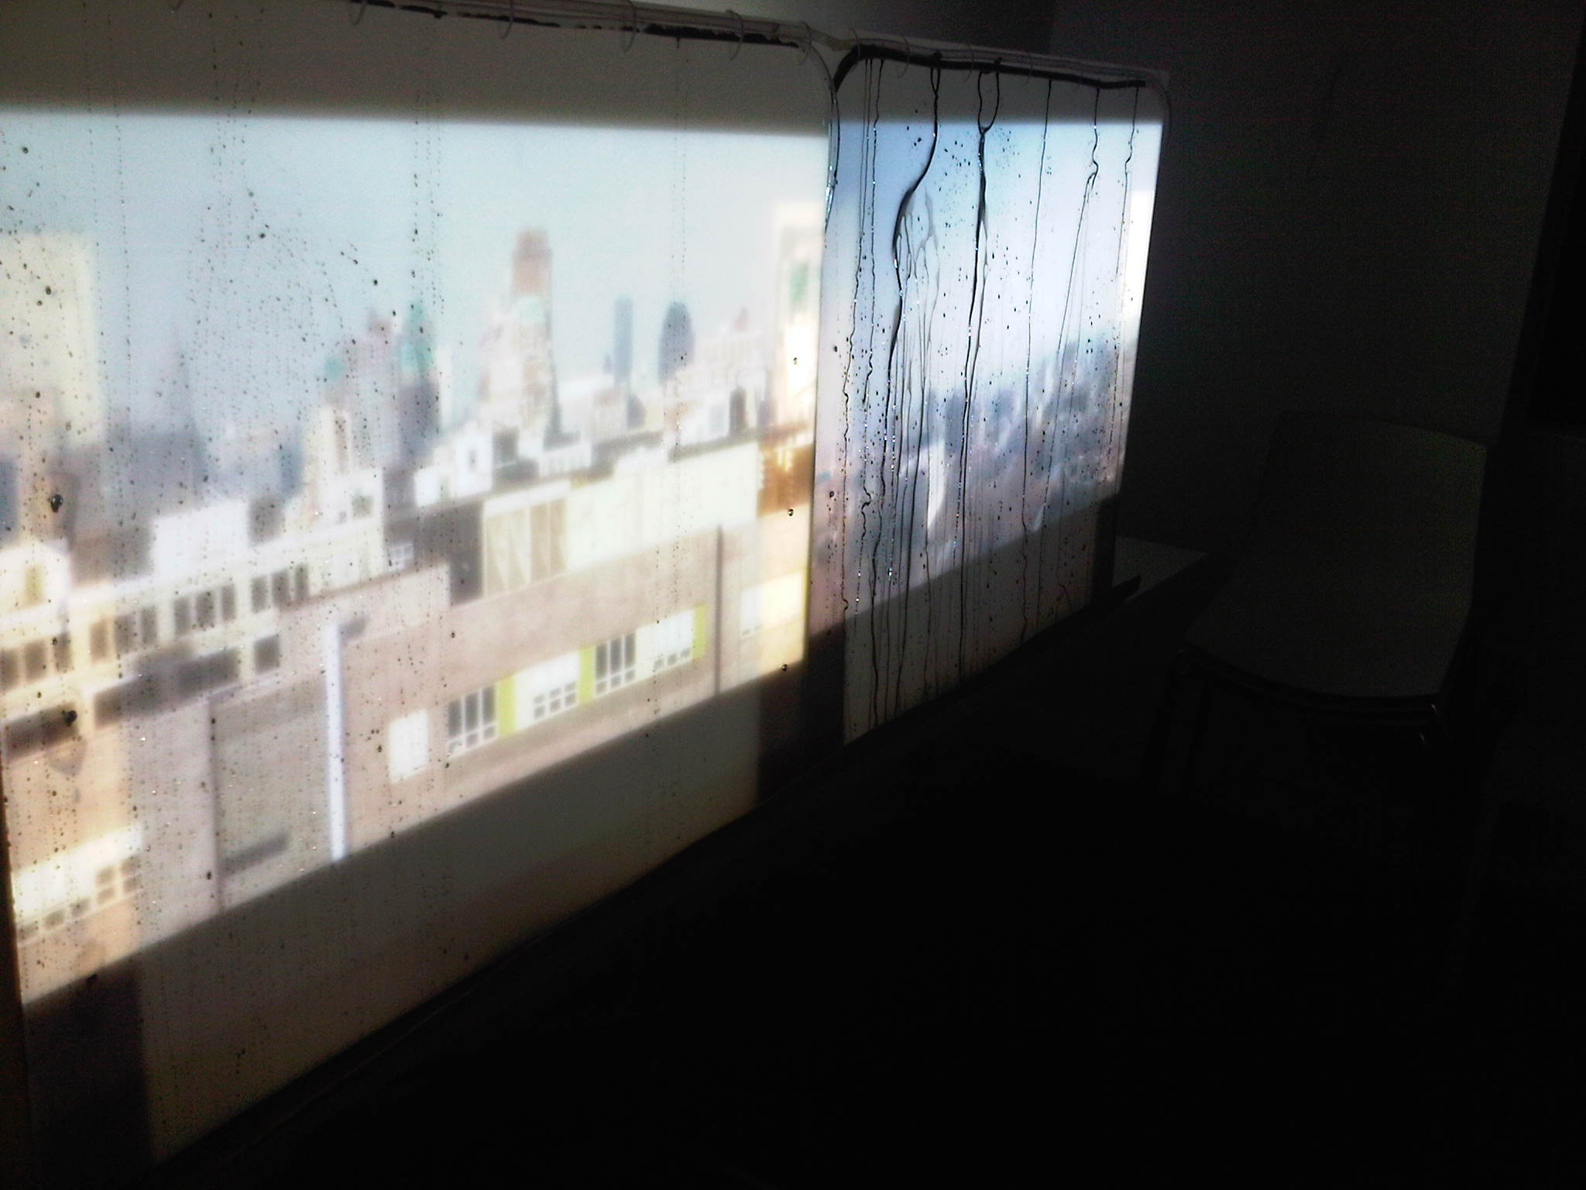
Final Version
Photo Documentation

Slide 9
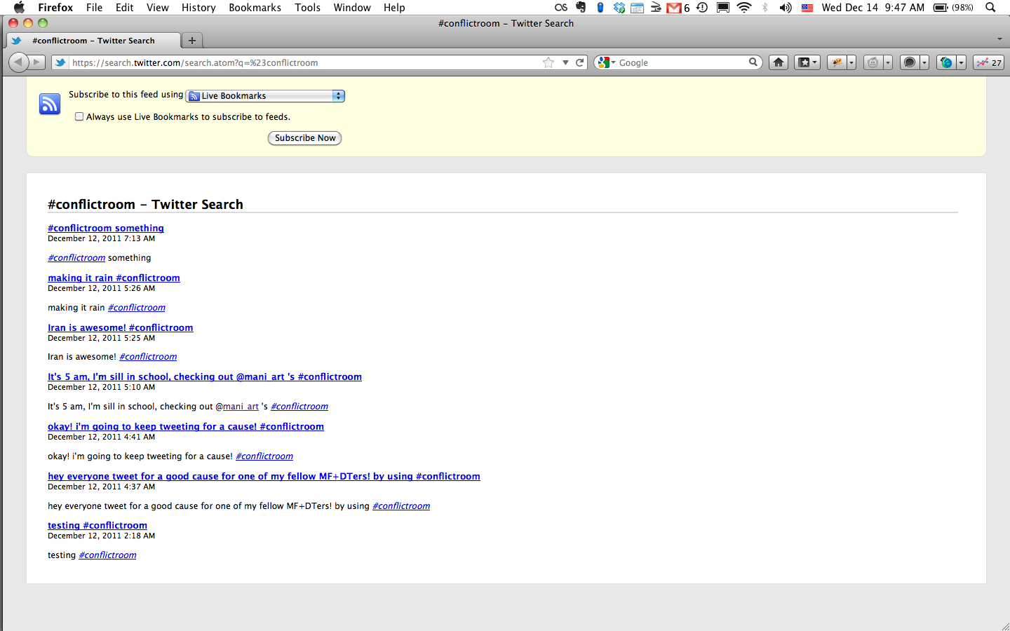
User Reaction / Testing
Tweets #conflictroom

Slide 10
Conclusions from user feedback
The project needs to be installed and run for a longer period of time to fully emerge and reflect the user interaction more effectively

Slide 11
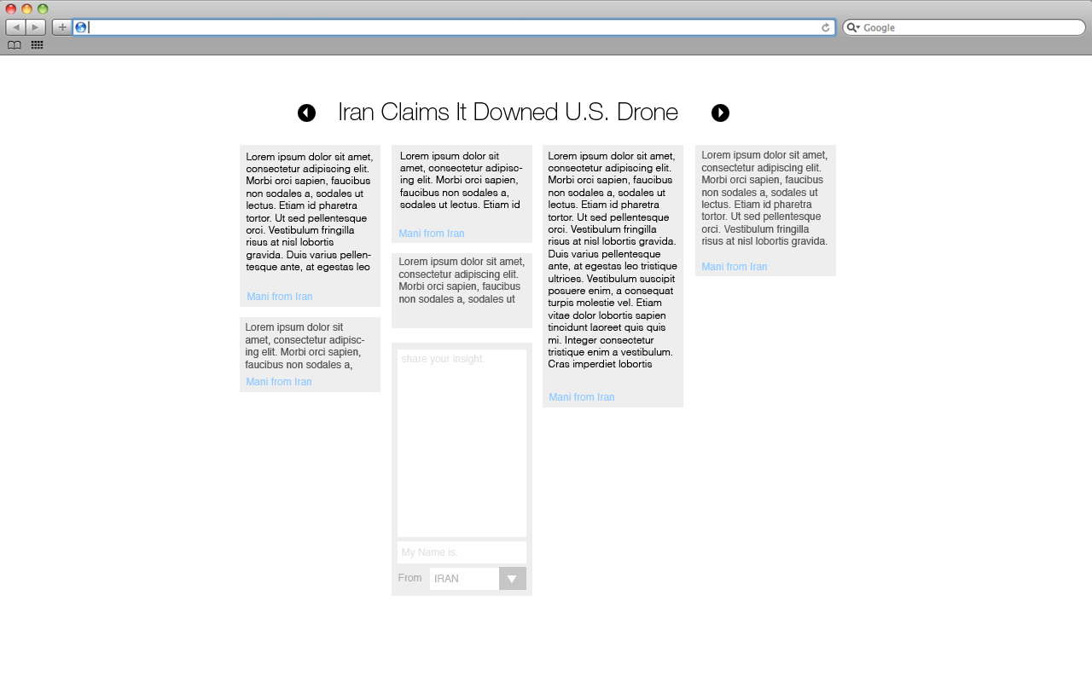
Future Ideas
Creating a platform for the citizens of the two countries to engage in conversations.

Slide 12
Questions / Comments ?

Slide 13
Thank you!
The Conflict Room http://mani-art.com/conflictroom/

