Slide 1
Aquarium Project Week#13
Tian Xie
Final Project – Major Studio

Slide 2
Concept
Powered by:
an Arduino,
a WiFly wireless module,
an RGB LED,
Twitter.com
and a Mac (Processing)
The Arduino connects directly to any wireless network via the WiFly module, continually searches Twitter for tweets with specific content, collates the tweets for each specific content, does some math, and then fades the color of the LED to reflect the current specific command;
White for normal statue,
Red for Feed,
Yellow for Play,
Blue for Change water,
Green for Clean,
Turn off for Sleep.

Slide 3
How to use it?
Please follow the Aquarium Project’s Twitter
Please comment on Aquarium Project daily tweet with
those specific words “ Feed/ Water/ Play/ Clean/ Sleep”
Those specific word can control the LED lights colors
Then the LED lights different colors can give different
commands to processing and show an animation.

Slide 4
Structure
Twitter: get new comments with specific words,
catch those out as a command for Arduino part.
Arduino: follow the comments with specific words
to change the RGB LED lights colors.
Processing: catch the different colors from Anduino,
then perform an animation.

Slide 5
Technical Support
Twitter Mood Light - The World's Mood in a Box
http://www.instructables.com/id/Twitter-Mood-Light-The-Worlds-Mood-in-a-Box/
WiFly Wireless Talking SpeakJet Server
http://www.sparkfun.com/tutorials/158

Slide 6
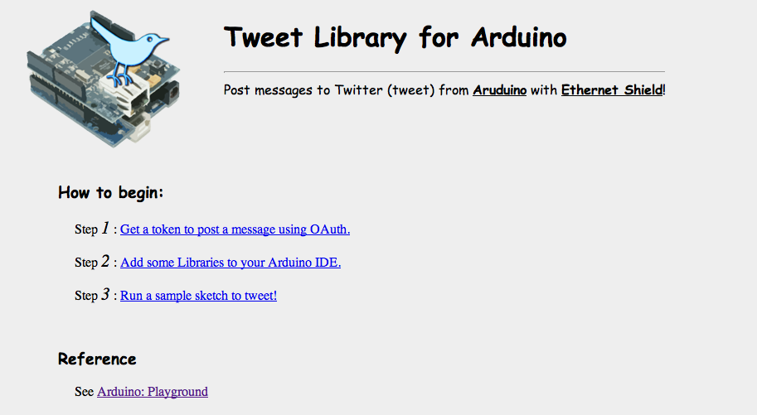
Preparation
How to connect Twitter and Arduino
Step1, Step2, Step3,

Slide 7
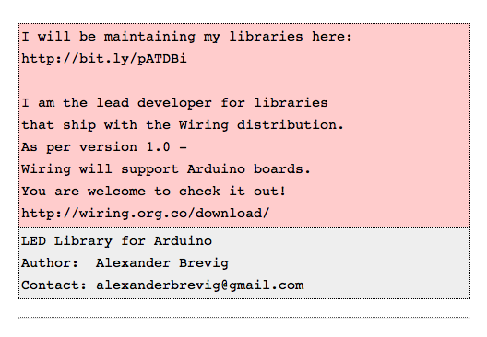
Preparation
How to set the LED lights, and work with Twitter.
Use LED library

Slide 8
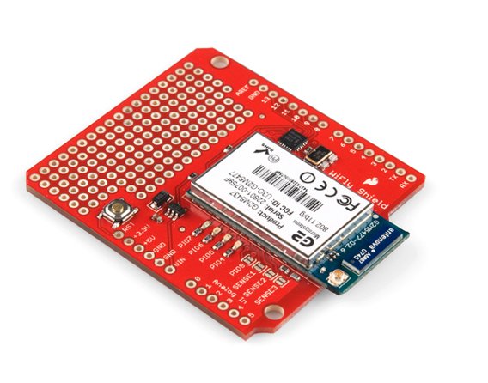
Prototyping#1
Arduino Part
Wifly
Router

Slide 9
Thank You!

